Slide 1


Introducing NoSQL and
ongodb
M
Pom Bleeksma & Lucas Jellema
14 March 2017, Nieuwegein

Slide 2
Agenda
Introduction
What’s not SQL about NOSQL – history, background, use cases
Overview of NoSQL databases
Introducing Mongodb
Getting started with MongoDB – installation, configuration, Administration
Developing with MongoDB – Java & Node.js
Handson Workshop

Slide 3
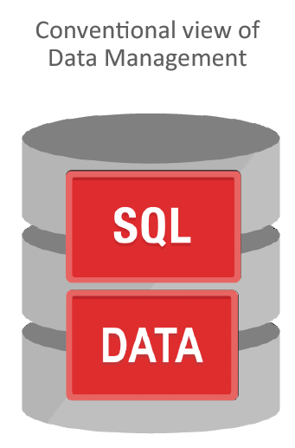
Traditional approach: all data in enterprise relational database

Slide 4
Traditional approach: Without much regard for
What is it used for?
By whom, where, in what way, using which tools
Ratio between writes and reads
Ad hoc access?
What format is it in/should it be in?
What confidentiality & integrity is required?
How much of it?
How long relevant (hot vs cold vs dead)?
How fine grained and how accurate?
How much change?

Slide 5
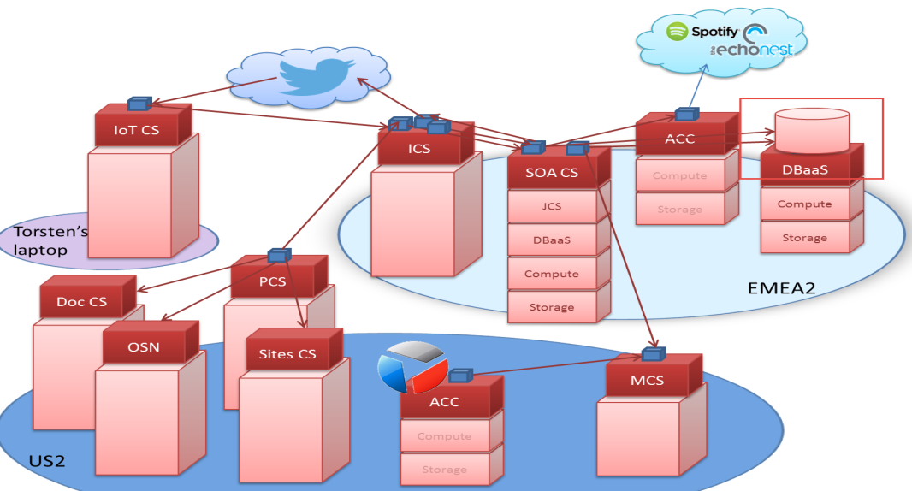
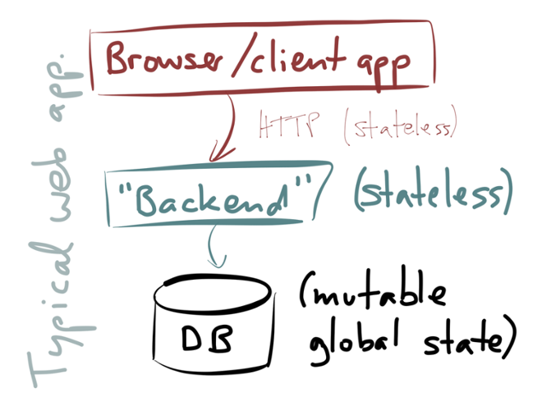
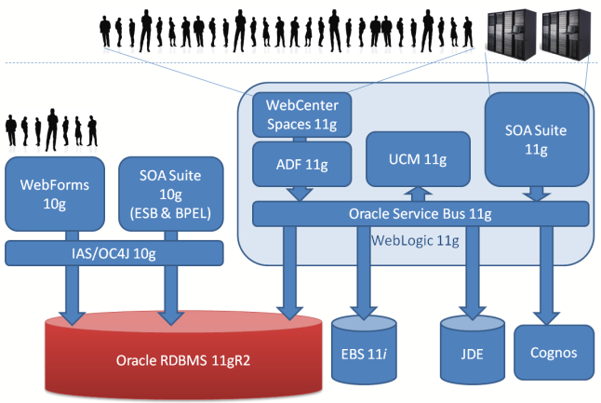
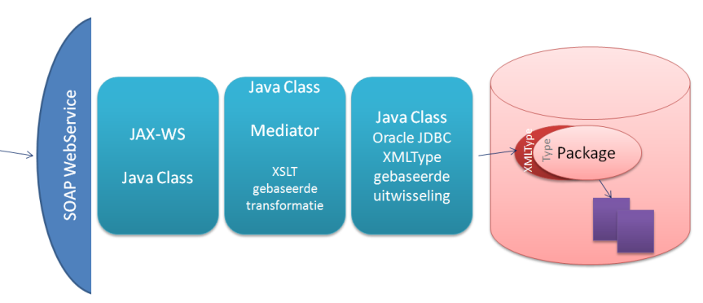
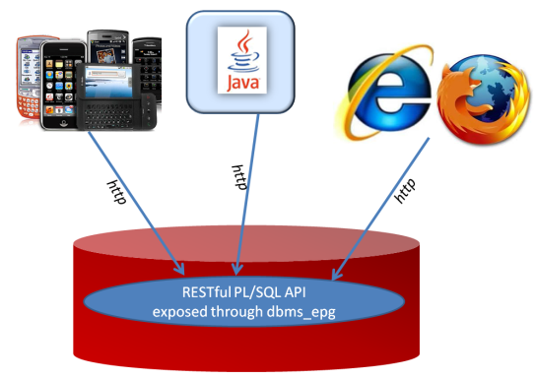
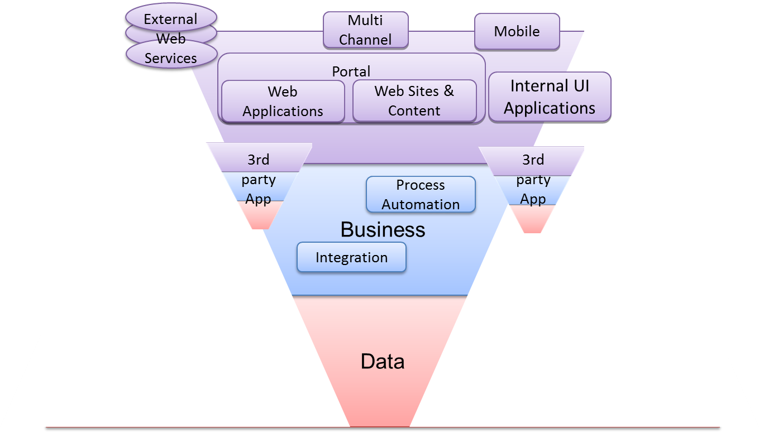
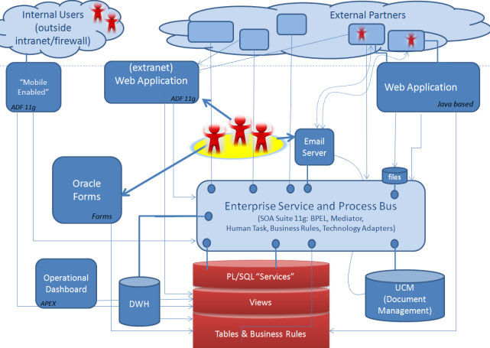
Database: single point of … Scalability | Availability | Consistency
Single Point of …
What goes where …

Slide 6
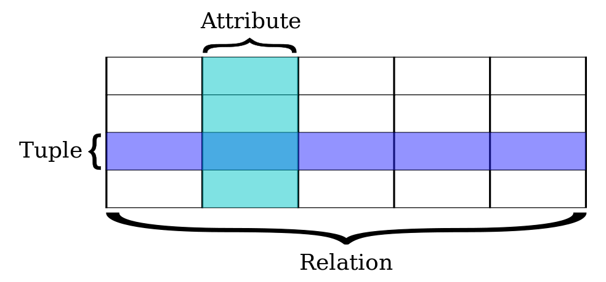
Relational Databases
Based on relational model of data (E.F. Codd), a mathematical foundation
Uses SQL for query, DML and DDL
Transactions are ACID (Atomicity, Consistency, Isolation, Durability)
All or nothing
Constraint Compliant
Individual experience [in a multi-session environment] (aka concurrency)
Down does not hurt

Slide 7

The holy grail of Normalization
Normalize to prevent data redundancy, discrepancies (split brain) and storage waste
Pragmatic approaches - recognizing the fact that some data is read far more frequently than that it is created and modified
Materialized View
Virtual Column
Index
Sharding
Replication
Data Guard
Data Warehouse & Data Marts
Client Side Caching
In Memory Database

Slide 8
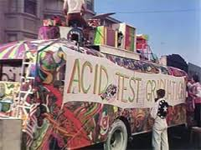
ACID comes at a cost
Transaction results have to be persisted in order to guarantee D
Concurrency requires some degree of locking (and multi-versioning) in order to have I
Constraint compliance (unique key, foreign key) means all data hangs together (as do all transactions) in order to have C

Slide 9
ACID comes at a cost
ACID means:
All data closely together (and sometimes far from applications and users)
All transactions centrally organized
All data persisted as part of the transaction
ACID means:
Hard to scale out (horizontally)
Oracle offers scale up with Real Application Clusters

Slide 10
The Relational Model in practice
Traditional Relational Data Model has severe impact on physical disk performance
Transaction Log => Sequential Write (append to file)
Data Blocks require much more expensive Random Access disk writes
Indexes (B-Tree, Bitmap, …) are used to speed up query (read) performance
and slow down transactions
Relational data does not [always] map naturally to data format required in application (OO, JSON, XML)
Capability to join and construct ad-hoc queries across the entire data model is powerful
Declarative integrity constraints allow for strict enforcement of data quality rules
“the data may be non sensical, but at least it adheres to the rules, whatever the origin”
SQL has been embraced by huge numbers of tools & technologies and IT/Data professionals

Slide 11
Databases re-evaluated
Not all use cases require ACID (or can afford it)
Read only (product catalog for web shops)
Inserts only and no (inter-record) constraints
Big Data collected and “dumped” in Data Lake (Hadoop) for subsequent processing
High performance demands
Not all data needs structured formats or structured querying and JOINs
Entire documents are stored and retrieved based on a single key
Sometimes – scalable availability is more important than Consistency – and ACID is sacrificed
CAP-theorem states: Consistency [across nodes], Availability and Partition tolerance can not all three be satisfied

Slide 12
Use Case: Webshop
Webshop – 1M visitors per day
Product catalog consists of millions of records
The web shop presents: product description, images, reviews, pricing details, related offerings, stock status
Products are added and updated and removed every day
Although most products do not change very frequently
Some vendors do bulk manipulation of product details
Webshop visits
searches
product details
orders
Products
Product updates

Slide 13
Use Case: Webshop Technology and architecture considerations
Webshop visits
searches
product details
orders
Products
Product updates
Read only
On line
Speed is crucial
XHTML & JSON
> 1M visits
Data manipulation
Data Quality (enforcement)
<10K transactions
Batch jobs next to online
Speed is nice
firewall

Slide 14
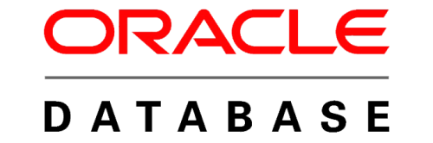

Use Case: Webshop Technology and architecture considerations
DMZ
Nightly generation
Webshop visits
searches
product details
orders
Products
Products
Products
Products
Product updates
Read only
On line
Speed is crucial
XHTML & JSON
> 1M visits
Data manipulation
Data Quality (enforcement)
<10K transactions
Batch jobs next to online
Speed is nice
Read only
JSON documents
Images
Text Search
Scale Horizontally
firewall

Slide 15
A few observations
Redundancy
for performance, scalability, availability
Commodity hardware for scale out architecture
Data (documents) prepared for specific application usage (super MV)
Format
Search paths
Time lag in data modifications is accepted
Perhaps even desirable to offer a consistent view to webshop users
Transactions in one engine
ACID still in place
Transactions do not compete with reads
vying for the same physical resources

Slide 16
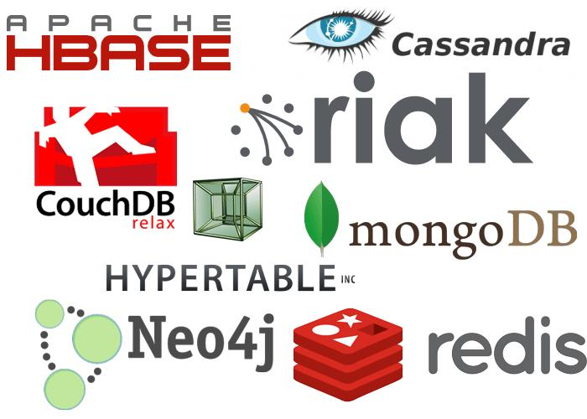
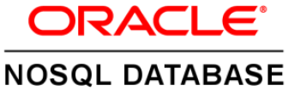
NoSQL and BASE
NoSQL arose because of performance and scalability challenges with Web Scale operations
NoSQL is a label for a wide variety of databases that lack some aspect of a true relational database
ACID-ness, SQL, relational model, constraints
The label has been used since 2009
Perhaps NoREL would be more appropriate
Some well known NoSQL products are
Cassandra, MongoDB, Redis, CouchDB, …
BASE as alternative to ACID:
basically available, soft state, eventually consistent (after a short duration)

Slide 17
Typical for NoSQL
Focus on speed, availability and scalability
Horizontal scale out – distributed with load balancing and fail-over
No (predefined) Data Structure
Integrity primarily protected by application logic
Open Source (most offerings are, not all: MarkLogic)
Close(r) attention for how the data is used
Application oriented data format and search paths and specialized database per application (microservice, capability)
Similar to the switch from SOA to API/Microservice
Reads (far) more relevant than writes
Data redundancy & denormalization
No data access through SQL

Slide 18
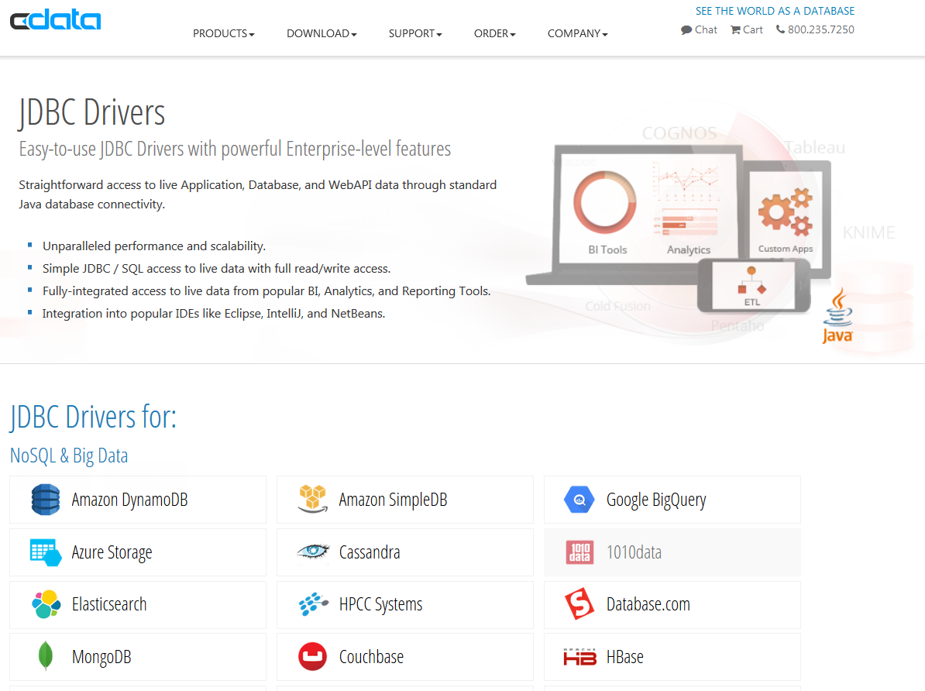
NoSQL means: No Data Access through SQL
However
Data Professionals and Developers speak SQL
Reporting, Dashboarding, ETL, BI tools speak SQL
There is no common query language across NoSQL products

Slide 19
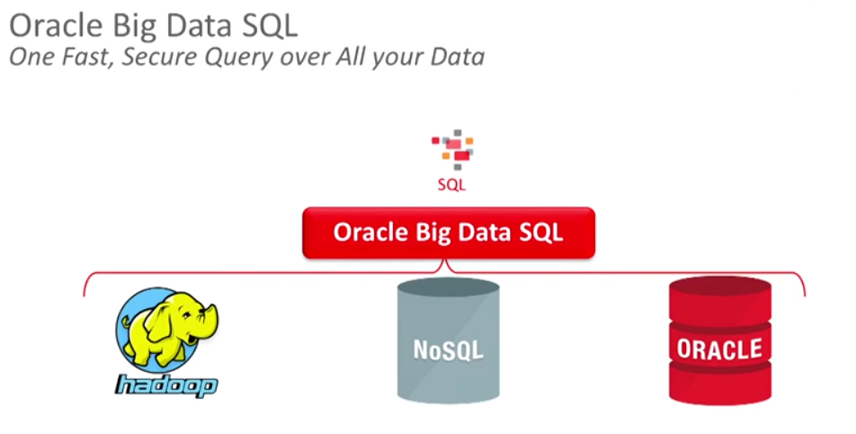
No Data Access through SQL
However
Data Professionals and Developers speak SQL
Reporting, Dashboarding, ETL, BI tools speak SQL
There is no common query language across NoSQL products
Attempts from many vendors to create drivers that translate SQL statements into NoSQL commands for the specific target database
To protect existing investments in SQL – skills, tools, applications, reports, ..

Slide 20
Types of NoSQL databaseS
Key-Value (from in-memory cache to hardware appliance – Memcached, Hazelcast, Coherence, Redis, Oracle NoSQL/Berkeley DB)
Wide Column Store (Cassandra, Google BigTable, HBase)
Document (JSON, XML, YAML and binary forms – MongoDB, CouchDB, Couchbase, MarkLogic)
Graph (networks of data, triplets, RDF stores – Neo4J)
Miscellaneous: object, tabular, tuple, elastic search index, Hadoop (hdfs) style, Kafka Topic

Slide 21
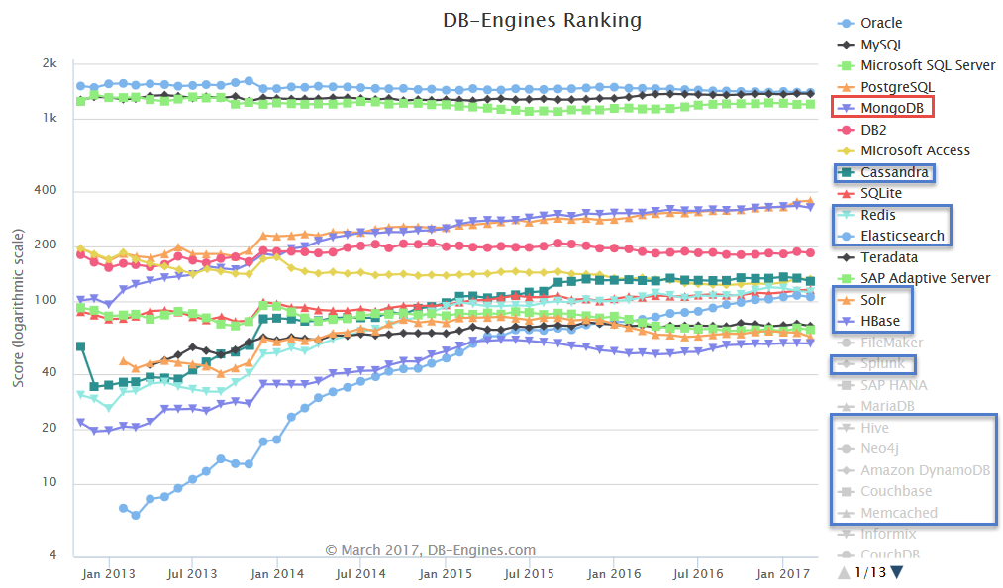
(leading) NoSQL Database products
MongoDB is (one of) the most popular (by any measure)
Cloud (only):
Google BigTable,
AWS Dynamo
Cache (in memory)
ZooKeeper, Redis, Memcached, …
Hadoop/HDFS
Oracle NoSQL (fka Berkeley DB)

Slide 23
History of MongoDB
10gen – startup from 2007 in New York City
Developed database as component in Platform as a Service product
Initial release of MongoDB: 2009
10gen changed its name to MongoDB Inc. in 2013
Offers enterprise support, MongoDB Atlas cloud service, MongoDB Compass, Connectors
Current stable release: 3.4.2 (3.5.2 is in preview)
Open Source - GNU Affero General Public License and the Apache License.
MongoDB == Humongous Database
Evolution of MongoDB is still pretty fast
Some crucial enterprise database capabilities were added fairly recently or are still lacking
MongoDB is number one NoSQL database in terms of popularity

Slide 24
Core Architecture
MongoDB stores JSON documents in a binary format (BSON)
Documents are stored in collections (similar to row or records in tables)
Interaction is through JavaScript
taking the place of SQL for DML and query
Written in C++
Has the V8 JavaScript engine included
Runs on Mac OS X, Windows, Solaris, and most flavors of Linux
Source code is on GitHub
Has GeoSpatial and Tekst indexes and search capabilities
MongoDB, Inc. officially supports drivers for C, C++, C#, Erlang, Java, Node.js, JavaScript, Perl, PHP, Python, Scala, and Ruby

Slide 25

Architectuur, installatie, configuratie, opslag, shell
Mongo draait op windows en linux.
Windows install met msi file
linux install met tgz file.
Users en directories vrij te kiezen
Mongod --dbpath db1-- port 27001
Default path=\data\db, default port=27017
Mongo [-- port hostname:27001] [--shell some_json_file]
Dbs, collections

Slide 26
Import export
Mongoimport
Json
Csv, tsv, maar hebben een descriptor file nodig
mongoexport -h -d -c -o -q
Leesbare output, minder geschikt voor backups

Slide 27
crud
show dbs
use db
db.<collection>.find()
db.<collection>.find().pretty()
select: db.find({key:value,key:value})
present: db.<collection>.find({key:value},{key:1,key:1,_id:0})
explain: db.find({key:value,key:value}).explain("executionStats")
db.companies.insert({Company:"AMIS",Event:"MongoDB Workshop"})
db.companies.update({Company:"AMIS"},{$set: {Location:"Nieuwegein"}})
Geen commit! Ofwel, autocommit.

Slide 28
crud
db.companies.remove({"Company" : "AMIS"})
$unset -> Om een veld uit een document te verwijderen.
$inc -> om een numeriek veld te verhogen met een bepaalde waarde. Als het veld niet bestaat wordt het toegevoegd (met de waarde van de verhoging)
$push -> Om een waarde aan een array toe te voegen.

Slide 29
Indexing, explain
_Id altijd geïndexeerd en unique
Indexen helpen bij zoeken
Indexen mogen compound zijn, dwz op meerdere keys gecombineerd, bv index op woonplaats+leeftijd
db.user.find().sort({ woonplaats:1, leeftijd: -1 }) De -1 betekent aflopend geïndexeerd.
Resultaten rechtstreeks uit index indien mogelijk (fat indexes in SQL)
db.user.find({woonplaats:”Zoetermeer”}).explain(“executionStats”) geeft een goed overzicht van het gevolgde plan

Slide 30
Replica sets
Replica sets zijn gedupliceerde collections
Beveilliging tegen uitval
De members besluiten onderling welk member primary is. Alleen daarop kan DML plaatsvinden
Altijd oneven aantal members, eventueel mbv een arbiter
Secondary members kunnen wel voor select gebruikt worden, als je eerst slaveOk() ingeeft
Mogen op dezelfde host draaien, mogen ook op verschillende hosts draaien.
writeConcern: Je kan expliciet aangeven op hoeveel members je DML uitgevoerd moet zijn voor je je prompt terug krijgt.

Slide 31
sharding
Shard = splinter
Range based partitioning
Altijd index nodig op de shard key. Hoeft niet unique te zijn.
Iedere shard is een proces. Bij voorkeur ieder proces zijn eigen host.
Scale out proces
Metadata staat in aparte config db. Typically 3 stuks.
Clients verbinden met een mongos server. Dat is een instance zonder database die uit de config haalt waar de data zich bevindt.
Iedere shard kan bestaan uit replica sets.

Slide 32
sharding
Data verdeelt zichzelf over chunks.
Chunks kunnen splitten wanneer ze te groot worden (typically 100MB maar is aan te passen naar wens)
Chunks kunnen migraten naar een andere chard. Mongo streeft ernaar elke shard evenveel chunks te laten hebben.
Tijdens migration kan DML gewoon doorgaan.

Slide 33
Backup & restore
Backup met mongodump
Creëert een dump directory met daaronder een directory per database en plaatst daarin 1 of meerdere .bson files, een binair formaat.
Kan vanaf ieder member van een replica set. Bij voorkeur eentje die het niet druk heeft.
Mongo kent geen transactions, dus backup is niet consistent. Het is maar afwachten wat erin staat als er veel DML plaatsvindt.
De tegenhanger heet mongorestore.
Restore van bestaande database lukt niet: duplicate key op _id

Slide 34
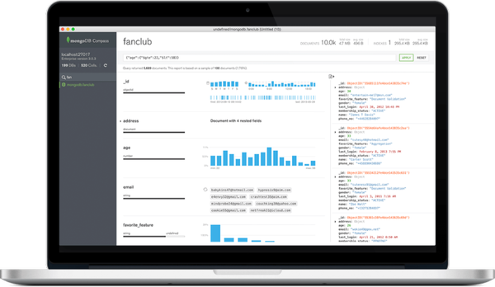
MongoDB Compass (aka NOSQL Developer)
The GUI for MongoDB
Visually explore data
Run ad hoc queries in seconds.
Interact with your data with full CRUD functionality
View and optimize your query performance.
Separately installed product
On Windows, OS X, Linux, …
Can run against local and remote MongoDB servers

Slide 35
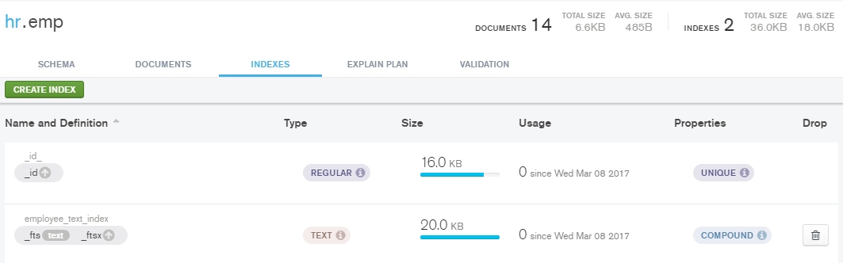
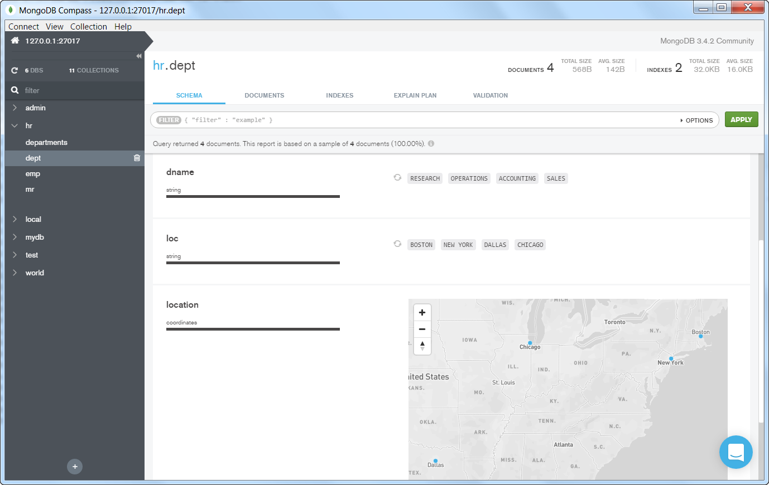
MongoDB Compass

Slide 36
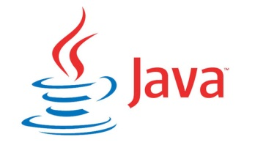

Programming against mongodb
MongoDB officially supports drivers for C, C++, C#, Erlang, Java, Node.js, JavaScript, Perl, PHP, Python, Scala, and Ruby
Note: there is also a Connector for Hadoop
Several REST APIs for MongoDB are available from the community
RESTHeart (Java), Eve (Python),, Crest (Node), AMID, Kule, DreamFactory
Connect, create, update
Connect, create, update

Slide 37
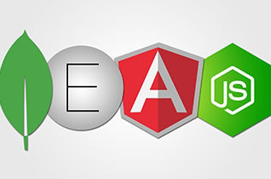
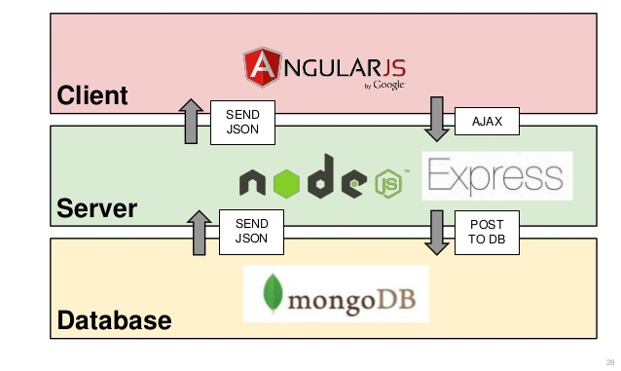
MEAN stack
Modelled after LAMP
End-to-End JavaScript/JSON
Term coined in 2013 (by MongoDB)

Slide 38
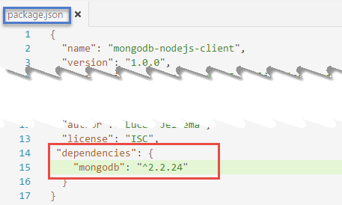
Interacting with Mongodb from Node.js
Connect, create, update
MongoDB Node.js Driver 2.0
Support for ECMAScript 6.0 – Promises for asynch
http://mongodb.github.io/node-mongodb-native/2.0/
Using mongodb in a NodeJS application
npm install mongodb –save
var MongoClient = require('mongodb').MongoClient;

Slide 39

Connecting to server
Connect, create, update
var MongoClient = require('mongodb').MongoClient;
var mongodbHost = '127.0.0.1';
var mongodbPort = '27017';
var mongodbDatabase = 'world';
var url = 'mongodb://'+mongodbHost+':'+mongodbPort + '/' + mongodbDatabase;
MongoClient.connect(url, function(err, db) {
console.log("Connected correctly to server.");
// DO YOUR THING WITH MONGODB
db.close();
console.log("Connection to database is closed.");
}) //connect()

Slide 40
Retrieve data (1)
Connect, create, update
var MongoClient = require('mongodb').MongoClient;
var mongodbHost = '127.0.0.1';
var mongodbPort = '27017';
var mongodbDatabase = 'world';
var url = 'mongodb://'+mongodbHost+':'+mongodbPort + '/' + mongodbDatabase;
MongoClient.connect(url, function(err, db) {
console.log("Connected correctly to server.");
db.collection('countries').find({},{"sort": [["area",-1]]}) .limit(20).toArray(function(err, results){
console.log("Name of Country Four " +results[3].name+ " and size: " +results[3].area); // using cursors to retrieve data sets in a controlled fashion // note: cursor implements NodeJS Stream - results can be piped
var cursor = db.collection('countries').find({"continent":"Asia"}, {"sort": "name"});
cursor.count(function(err, count){
console.log("Country count in Asia: "+count);
});
cursor.each(function(err, country){
console.log(country.name);
})//each cursor

Slide 41
Retrieve data (2)
Connect, create, update
var aggquery = [ {$sort: {area : -1}}
, {$group:{ _id: '$continent'
, largestCountry : {$first: "$name"}
}
}
];
var aggcursor = db.collection('countries').aggregate(aggquery);
aggcursor.each(function(err, result){
if (err) {
console.log(err);
} else if (result)
console.log(JSON.stringify(result));
}) //each aggcursor
var ccursor = db.collection('countries').find({});
// the cursor returned from find and aggregate implements a NodeJS (readable) Stream
ccursor.on('data', function(doc) {
console.log(doc);
});
ccursor.once('end', function() {
console.log(“Out of countries. Time to move on");
});

Slide 42
Connecting to server – ECMA 6
Connect, create, update
var MongoClient = require('mongodb').MongoClient;
var assert = require('assert'), co = require('co');
var mongodbHost = '127.0.0.1';
var mongodbPort = '27017';
var mongodbDatabase = 'world';
var url = 'mongodb://'+mongodbHost+':'+mongodbPort + '/' + mongodbDatabase;
co(function*() {
// Use connect method to connect to the Server
var db = yield MongoClient.connect(url);
console.log("Connected correctly to server");
// DO YOUR THING WITH MONGODB
// Close the connection
db.close();
}).catch(function(err) {
console.log(err.stack);
});

Slide 43
Retrieve documents – ECMA 6
Connect, create, update
co(function*() {
// Use connect method to connect to the Server
var db = yield MongoClient.connect(url);
console.log("Connected correctly to server");
// find top 20 countries by size
var results = yield db.collection('countries').find({} ,{"sort": [["area",-1]]}).limit(20).toArray();
console.log("Country One " +JSON.stringify(results[0]));
console.log("Name of Country Four " +results[3].name + " and size: " +results[3].area);
// use cursor to get the country count
var cursor = db.collection('countries').find({"continent":"Asia"} , {"sort": "name"});
var count = yield cursor.count();
console.log("Country count in Asia: "+count);
while (yield cursor.hasNext()){
var country = yield cursor.next();
console.log(country.name);
}

Slide 44
Retrieve documents (2) – ECMA 6
Connect, create, update
// the largest country per continent
var aggquery = [ {$sort: {area : -1}}
, {$group:{ _id: '$continent'
, largestCountry : {$first: "$name"}
}
}
];
var aggcursor = db.collection('countries').aggregate(aggquery);
while (yield aggcursor.hasNext()){
var result = yield aggcursor.next();
console.log(JSON.stringify(result));
}
// Close the connection
db.close();
}).catch(function(err) {
console.log(err.stack);
});//co

Slide 45
CREATE docs in MongoDB – ES6
Connect, create, update
// define two documents, any structure you like
var doc = {
"continent" : "Europe",
"children" : [ {"name":"Belgium"}, {"name":"Luxemburg"}],
"someVariable" : 19123, "andmore" : "2716NK" };
var doc2 = {
"continent" : "Asia", "name" : "Johnny",
"nrs" : [ {"name":"China"}, {"name":"India"}, {"name":"Buthan"}],
"tree": {"branch": {"twig":{"leaf": 1}}}
};
var nameOfCollection = "myDocs"
var result = yield db.collection(nameOfCollection).insertMany([doc,doc2]);
console.log(">> "+result.insertedCount +" documents created into collection "+nameOfCollection);
...

Slide 46
CREATE & Update docs – ES6
Connect, create, update
// define two documents, any structure you like
var doc = {...}, doc2 = {...} , nameOfCollection = "myDocs“;
var result = yield db.collection(nameOfCollection).insertMany([doc,doc2]);
console.log(">> "+result.insertedCount +" documents created);
var cursor = db.collection(nameOfCollection).find();
while (yield cursor.hasNext()){
var doc = yield cursor.next();
console.log("Document: " +JSON.stringify(doc));
}// while cursor
result = yield db.collection(nameOfCollection).updateOne( {"tree.branch.twig.leaf":1}, {$set: {name: "Hank", city:"Nieuwegein“ , "location.province":"Utrecht“ , "location.country":"The Netherlands“ , "tree.stem":5}});
console.log(">> Updated "+result.modifiedCount+" document(s)");
cursor = db.collection(nameOfCollection).find();
while (yield cursor.hasNext()){
var doc = yield cursor.next();
console.log("Document: " +JSON.stringify(doc));
}// while cursor

Slide 47
CREATE, Update and Delete – ES6
Connect, create, update
// define two documents, any structure you like
var doc = {...}, doc2 = {...} , nameOfCollection = "myDocs“;
var result = yield db.collection(nameOfCollection).insertMany([doc,doc2]);
console.log(">> "+result.insertedCount +" documents created);
var cursor = db.collection(nameOfCollection).find();
while (yield cursor.hasNext()){
var doc = yield cursor.next();
console.log("Document: " +JSON.stringify(doc));
}// while cursor
result = yield db.collection(nameOfCollection).updateOne(...); ...
result = yield db.collection(nameOfCollection).deleteMany({});
console.log(">> Deleted "+ result.deletedCount+" documents ");
// execute command to drop the collection
yield db.command({drop:nameOfCollection});
console.log(">> Dropped collection "+nameOfCollection);
// Close the connection
db.close();
console.log("Connection to database is closed.");

Slide 48
CREATE documents in MongoDB
Connect, create, update
// define two documents, any structure you like
var doc = {
"continent" : "Europe",
"children" : [ {"name":"Belgium"}, {"name":"Luxemburg"}],
"someVariable" : 19123, "andmore" : "2716NK" };
var doc2 = {
"continent" : "Asia", "name" : "Johnny",
"nrs" : [ {"name":"China"}, {"name":"India"}, {"name":"Buthan"}],
"tree": {"branch": {"twig":{"leaf": 1}}}
};
var nameOfCollection = "myDocs"
db.collection(nameOfCollection).insertMany([doc,doc2], function(err, r) {
console.log(r.insertedCount+" docs created in "+nameOfCollection); ... }

Slide 49
CREATE and delete documents
Connect, create, update
// define two documents, any structure you like
var doc = {...} ;
var doc2 = {...} ;
var nameOfCollection = "myDocs"
db.collection(nameOfCollection).insertMany([doc,doc2], function(err, r) {
console.log(r.insertedCount+" docs created in "+nameOfCollection); // retrieve, show and delete afterwards
var cursor = db.collection(nameOfCollection).find();
cursor.each(function(err,doc){
// all documents returned, cursor depleted; done
if (!doc) {
// remove litter
db.collection(nameOfCollection).deleteMany({}, function(err, r) {
console.log("Deleted "+ r.deletedCount+" docs from "+nameOfCollection);
db.close();
console.log("Connection to database is closed.");
}); //deleteMany
}//if
else {
console.log("Document: " +JSON.stringify(doc));
}
})//find.each
});// insertMany

Slide 50
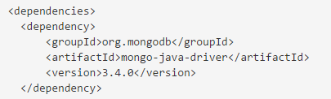
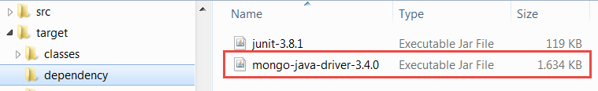
Interacting with Mongodb from Java
Connect, create, update
MongoDB Java Driver 3.x
Supports Synchronous and Asynchronous operations
https://docs.mongodb.com/ecosystem/drivers/java/
Using MongoDB Driver in a Java Application
Add dependency in Maven pom.xml file
Library JAR file mongo-java-driver-3.4.0.jar

Slide 51
Connecting to server
Connect, create, update
package nl.amis.mongodb.countries;
import java.net.UnknownHostException;
import com.mongodb.MongoClient;
import com.mongodb.client.MongoDatabase;
public class AppConnect {
public static void main(String[] args) throws UnknownHostException {
String mongodbHost = "127.0.0.1";
Integer mongodbPort = 27017;
String mongodbDatabase = "world";
MongoClient mongoClient = new MongoClient(mongodbHost, mongodbPort);
try {
System.out.println("Connected to server; now hook into database " + mongodbDatabase);
MongoDatabase db = mongoClient.getDatabase(mongodbDatabase);
System.out.println("Connected to database " + mongodbDatabase + " successfully");
} finally {
mongoClient.close();
System.out.println("Closed mongodb connection");
}
}
}

Slide 52
Retrieve Data
Connect, create, update
... import org.bson.Document;
import com.mongodb.client.MongoCollection;
public class AppConnect {
public static void main(String[] args) throws UnknownHostException {
... Connect to world database
// get all documents from the countries collection
MongoCollection<Document> countries = db.getCollection("countries");
System.out.println("Got collection countries successfully");
System.out.println("Number of countries: " + countries.count());
System.out.println("All countries - name and continent");
for (Document doc : countries.find()) {
// System.out.println(doc.toJson());
System.out.println(doc.get("name") + " (" + doc.get("continent") + ")");
}//for

Slide 53
Retrieve data (2)
Connect, create, update
import com.mongodb.client.model.Sorts;
import com.mongodb.client.model.Filters;
import com.mongodb.Block;
public class AppConnect {
public static void main(String[] args) throws UnknownHostException {
... Connect to world database
System.out.println( "Retrieve all countries in Asia order alphabetically by name and display full country document");
countries.find(Filters.eq("continent", "Asia")) .sort(Sorts.ascending("name"))
.forEach(new Block<Document>() {
@Override
public void apply(final Document document) {
System.out.println(document.toJson());
}
});

Slide 54
Retrieve data - Aggregation
Connect, create, update
...
Block<Document> printBlock = new Block<Document>() {
@Override
public void apply(final Document document) {
System.out.println("Country: " + document.toJson());
}
};
... System.out.println("List largest country in each continent");
countries.aggregate(
Arrays.asList(
Aggregates.sort(Sorts.descending("area")),
Aggregates.group("$continent", Accumulators.first("Largest Country", "$name"))
))
.forEach(printBlock);

Slide 55
Retrieve data – Aggregation (2)
Connect, create, update
System.out.println("List name in uppercase,sorted by size, delta between birthdate and deathrate, " +" population density for countries in Oceania");
BsonArray subArgs=new BsonArray();
subArgs.add(new BsonString("$birthrate"));
subArgs.add(new BsonString("$deathrate"));
BsonArray divArgs=new BsonArray();
divArgs.add(new BsonString("$population"));
divArgs.add(new BsonString("$area"));
countries.aggregate
(Arrays.asList(
Aggregates.match(Filters.eq("continent", "Oceania")),
Aggregates.sort(Sorts.descending("area")),
Aggregates.project( Projections.fields(
Projections.excludeId(),
Projections.include("continent"),
Projections.computed("name",Projections.computed("$toUpper", "$name")),
Projections.computed("populationGrowthRate",Projections.computed("$subtract", subArgs)),
Projections.computed("populationDensity", Projections.computed("$trunc", Projections.computed("$divide", divArgs)))
))
))
.forEach(printBlock);

Slide 56
Java: Create documents in Mongodb
Connect, create, update
... String nameOfCollection = "myDocs";
MongoCollection<Document> coll = db.getCollection(nameOfCollection);
Document doc1 = new Document("continent", "Europe")
.append("nrs", Arrays.asList(new Document("name", "Belgium"),
new Document("name", "Luxemburg")))
.append("someVariable", 19123)
.append("andmore", "kl;jdsfakhfsdahjfsdasjbsdahjbsdahgvsahjkZl;po");
Document doc2 = new Document("continent", "Asia").append("name", "Johnny")
.append("nrs", Arrays.asList(new Document("name", "China"),
new Document("name", "India"), new Document("name", "Buthan")))
.append("tree", new Document("branch",
new Document("twig", new Document("leaf", 1))));
List<Document> documents = new ArrayList<Document>();
documents.add(doc1);
documents.add(doc2);
coll.insertMany(documents);
System.out.println(">> Documents created into collection");
coll.find().forEach(printBlock);

Slide 57
Java: Update and Delete Data
Connect, create, update
... coll.updateOne(
Filters.eq("tree.branch.twig.leaf", 1),
Updates.combine( Updates.set("name", "Hank"), Updates.set("city", "Nieuwegein"),
Updates.set("location.province", "Utrecht"),
Updates.set("location.country", "The Netherlands"),
Updates.set("tree.stemp", 5),
Updates.currentDate("lastModified")
)
);
System.out.println(">> Updated one document in collection " + nameOfCollection);
coll.find().forEach(printBlock);
DeleteResult dr = coll.deleteMany(Filters.exists("_id"));
System.out.println(">> Deleted " + dr.getDeletedCount() + " documents from collection "
+ nameOfCollection);
db.runCommand(new Document("drop", nameOfCollection));
System.out.println(">> Dropped collection " + nameOfCollection);

Slide 58

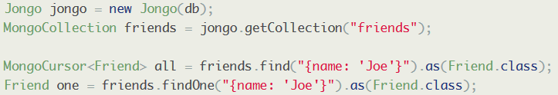
Interacting with Mongodb from Java – JSON ⬄ OO mapping
Connect, create, update
Libraries for mapping between BSON/JSON documents and Java Objects
Morphia - http://mongodb.github.io/morphia/1.3/getting-started/quick-tour/
Jongo – Query in Java as in the MongoDB shell - http://jongo.org/

Slide 59

Hands on Workshop
Install MongoDB
Create Database, Create Collections and Documents
Retrieve Data
Import Database
More configuration and administration
Development: interacting with MongoDB from
Compass
Java
Node.js

Slide 60



Resources: https://github.com/lucasjellema/sig-nosql-mongodb
Blog: technology.amis.nl
Email: pom.bleeksma@amis.nl , lucas.jellema@amis.nl
: @lucasjellema
: lucas-jellema
: www.amis.nl, info@amis.nl +31 306016000 Edisonbaan 15, Nieuwegein

